Slide 1
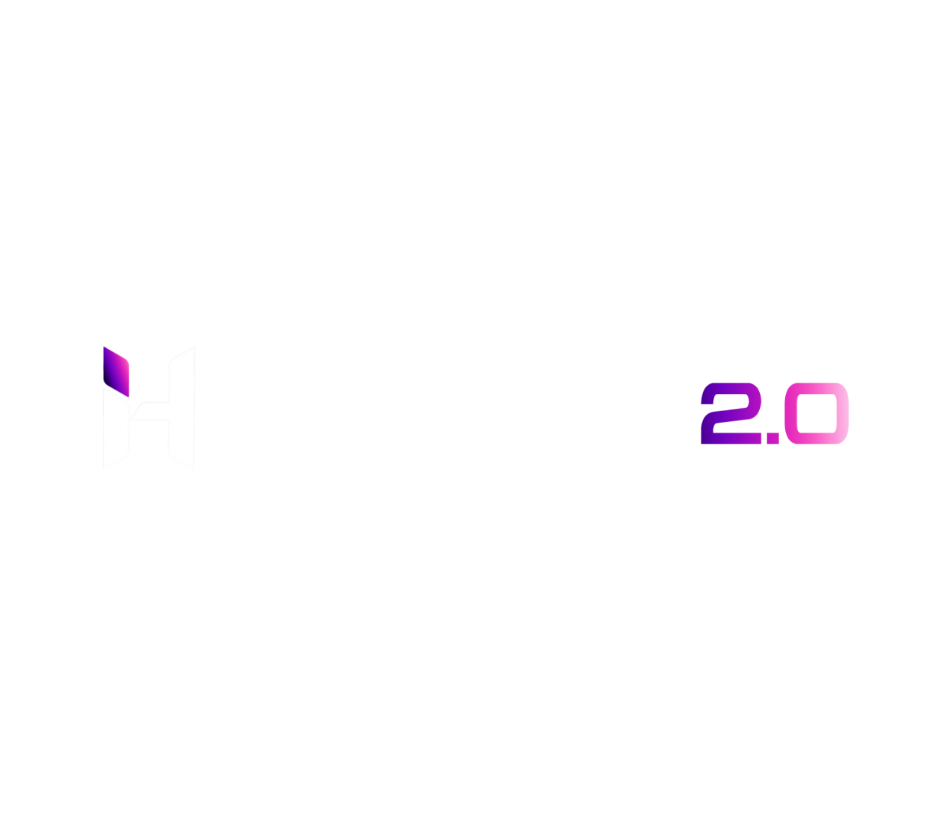



Team Name and Members Details
Hack n' Innovate
REVIVERS2.0
ABHISHEK MALHOTRA-1ST YEAR(CSE)
DEEPENDRA SINGH-3RD YEAR(CSE)
YASHIKA PANDEY-2ND YEAR(CSE)
Theme :
[HEALTH CARE]

Slide 2
Problem Statement
Deaf and mute people face several difficulties when it comes to communicating with computers. Here are some
of the most common challenges:
Lack of audio feedback: Deaf individuals cannot hear audio feedback from the computer, such as system sounds, music, or voice prompts. This can make it difficult to interact with certain applications or to confirm that a task has been completed.
Limited speech recognition: Some deaf and mute individuals may use speech recognition software to communicate with their computer. However, this technology can be unreliable and may not work well for individuals with speech impairments or heavy accents.
Limited access to video content: Many online videos and multimedia content rely on audio cues, making them difficult for deaf individuals to understand. While some videos may have closed captions, not all content creators provide them.
Limited access to voice assistants: Voice assistants such as Siri or Alexa rely on spoken commands, making them difficult for deaf individuals to use. While some devices have visual feedback or sign language recognition, these features are not always available or accessible.
Limited access to sign language interpreters: Some deaf individuals may require sign language nterpreters to communicate with others, but finding and coordinating with interpreters can be challenging, especially in remote or online settings.

Slide 3
Handisys is a mobile application which helps connecting physically challenged people with muteness, deafness and blindness.
As for common folks, the app provides a platform to go hands free and configure the device from a distance.
There are existing technologies but those are not cost efficient but ours is.Physically challenged people face a lot of problems in day to day life to communicate with each other.
It is using sign language and converting it to text and audio.
And for normal use case, in the time of coding when we can't use our hands to touch we could have used it and in future we can.
In the era of digitalisation it will help in hands free banking,driving and instructing which will make everything easy.
Proposed Solution
Use Case
EASE OF COMMUNICATION
IMMERSIVE INTERACTIVE APPLICATION
HANDS FREE DEVICE CONTROL
VAST SCOPE IN DIGITALISATION

Slide 4
EASE OF COMMUNICATION
HANDS FREE DEVICE CONTROL
This Application designed for differently abled people often focus on providing ease of communication through visual cues and real-time translation services.
These apps aim to bridge the communication gap between deaf and hearing individuals by providing a platform for communication that accommodates the unique needs of the deaf community.
One of the key features of app for deaf people is real-time captioning. This allows for live conversations to be transcribed in real-time.
Hands-free device control refers to the ability to operate electronic devices without the use of hands.
Our application use Motion detection technology in hands-free device control. This technology allows users to control their devices by making hand gestures or moving their head. This technology is often used in gaming consoles.
It can also be used in other contexts, such as in the automotive industry, where drivers can control certain functions of their vehicles using hand gestures.
IMMERSIVE INTERACTIVE LEARNING
VAST SCOPE OF DIGITALISATION
An immersive interactive application is a type of software application that provides users with a highly engaging and interactive experience.
These applications typically use to create an environment where users can interact with digital objects and characters in a more natural and intuitive way.
Our application this feature can be used in various games along side with the help of differently abled people in every possible way
The use of hands-free technology has become increasingly important in digitalisation.
In manufacturing, hands-free technology is being used to improve efficiency and safety. For example, workers can use this app to receive real-time instructions and guidance while working on complex machinery, reducing the risk of errors and accidents.
This application can be used in ATM machine for commanding.
It can also be used in industry machines which are sensitive of touch and can be used and operated using gestures.

Slide 5
Flow of development
Tech-stack
Details about our approach
GUI
Prediction
Scan hand gestures
This app uses image processing in real time .
Predict the output
Open CV
Our model predicts the gestures of hands.
TKINTER
Form sentences with different gestures
Text to
speech
Hand
tracing
Form meaningful sentences of user desire.
This output is voiced by an AI and the process can also go vice versa.
Use formed gestures
gTTs
Mediapipe
Either to automate system or to communicate.

Slide 6
USP
Scalability of Solution
Unique points
Selling points
We are replacing human mediator with the complete automated softwares.
Anyone can use it with their personal computers , no need to go anywhere that’s why it is cost effective
Accessible to anyone who has mobile, laptop or pc.
Connect physical challenged people such as mute people, deaf people and blind people with normal people.
Provide new way of handling systems
We have replaced additional devices like ARDUINO,ultrasonic sensors with Handisys
The sensors used in existing technology costs Rs.1379 but our application do not require any sensors like this.
GUI is simple and interactive , anyone can use it without any major prior tech knowledge.

